Slide 1
Ecphrastic poetry & the development of professional literacy in biology

Slide 2
What is ecphrastic poetry?
Ecphrastic poetry is the conversation between two pieces of art. The writer interprets a work of visual art and then creates a narrative in verse form that represents his or her reaction to that painting, photograph, sculpture or other artistic creation.
http://www.firkinfiction.com/11.html

Slide 3
Ecphrastic poetry and biology
How do you write a biology-related poem in an ecphrastic manner?
Complete the following steps:
View a stimulus image and identify a biology-related concept it evokes.
If required, write down the concept, definition, law, formula etc.
Identify a suitable poetry type and write the poem.

Slide 4
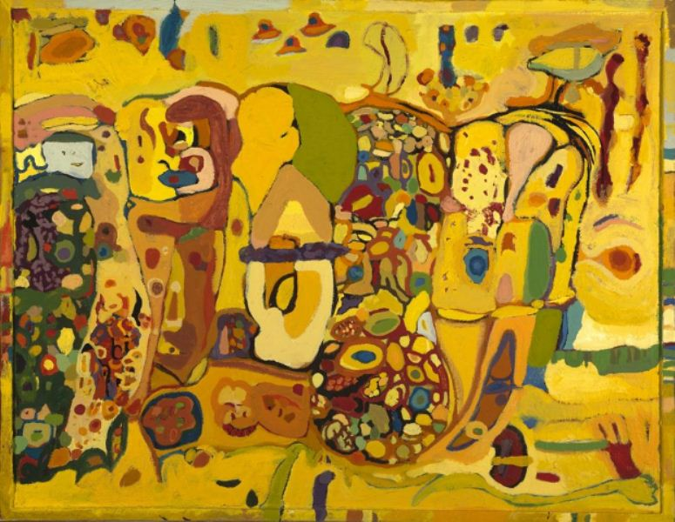
What concept does this image evoke?
http://www.artists2artists.net/photo/chloroplast-1

Slide 5
Chloroplasts

Slide 6
Example Haiku poem
Small green chloroplasts
capture energy from light
and thus make glucose.

Slide 7
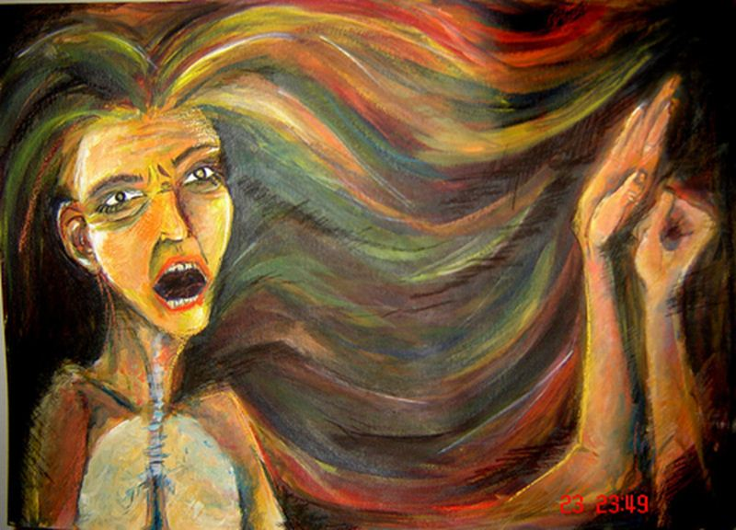
What concept does this image evoke?
http://farm4.static.flickr.com/3204/3013844752_11ef8afabf.jpg

Slide 8
The respiratory system

Slide 9
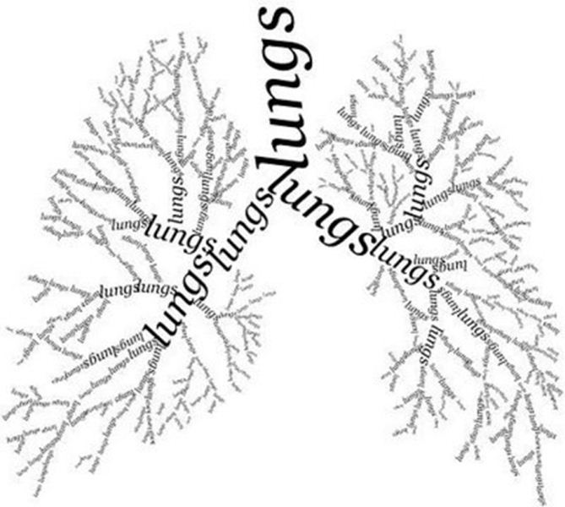
Example Concrete poem
http://2.bp.blogspot.com/_n3VhR-tzxLo/SQdgh7iVveI/AAAAAAAAACg/dfGx_z__jdI/s400/l_cf7336c081d7493481f5a9bc149e00ae.jpg/

Slide 10
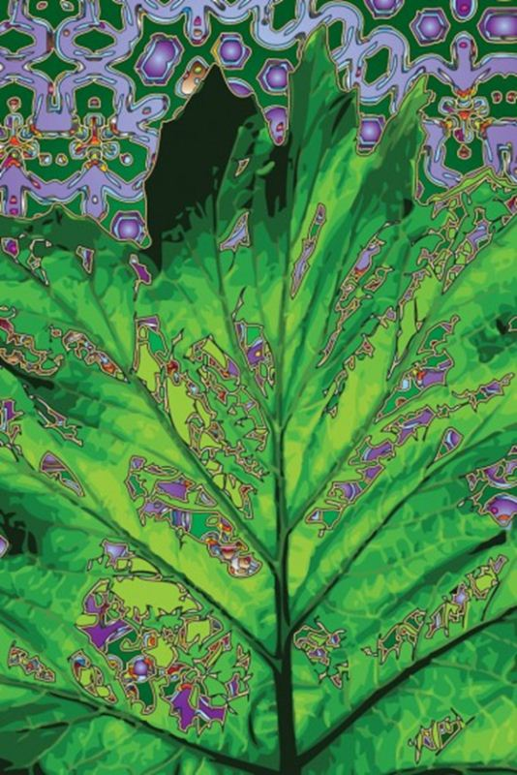
What concept does this image evoke?
http://www.artsyhome.com/wp-content/uploads/2011/04/Brieske-Photosynthesis-380x570.jpg

Slide 11
Photosynthesis

Slide 12
Example Acrostic poem
Plants
Heterotrough
Oxygen
Temperature
Outdoors
Sunlight
Your source of oxygen
Nourishment (makes own food)
Trees
H2O (water)
Energy
Soil
In order to survive all organisms must release energy in sugars
Sugars
http://wiki.answers.com/Q/Can_you_make_an_acrostic_poem_about_photosynthesis

Slide 13
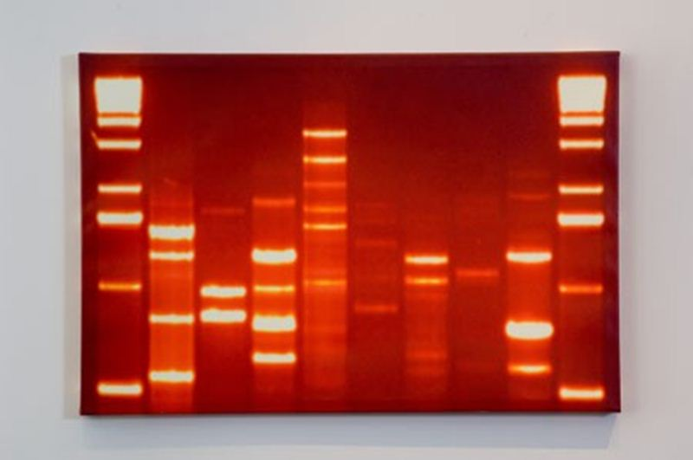
What concept does this image evoke?
http://idnaart.com/wp-content/gallery/ruby-red-dna-art/ruby-red.jpg

Slide 14
DNA

Slide 15
Example Limerick poem
I’m the whole of my parts, so they say!
And unique are my parts, DNA.
They’re tiny in size,
But they sure humanize
My nature and features, óle!
http://jcdverha.home.xs4all.nl/scijokes/4_1.html#subindex

Slide 16
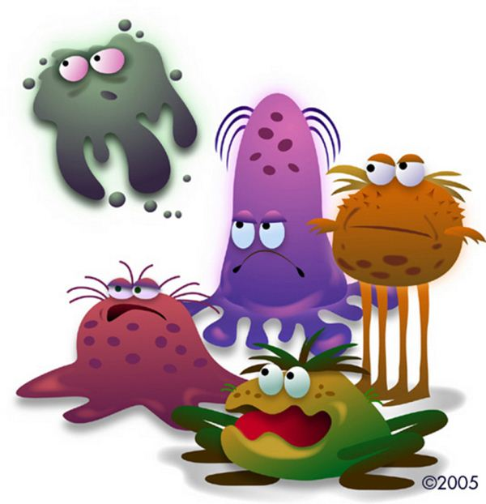
What concept does this image evoke?
http://www.healthandphysicaleducationteacher.com/wp-content/uploads/2011/03/germs.jpg

Slide 17
Germs

Slide 18
Example Free Verse poem
A mighty creature is the germ,
Though smaller than the pachyderm.
His customary dwelling place
Is deep within the human race.
His childish pride he often pleases
By giving people strange diseases.
Do you, my poppet, feel infirm?
You probably contain a germ.
http://jcdverha.home.xs4all.nl/scijokes/4_1.html#subindex

Slide 19
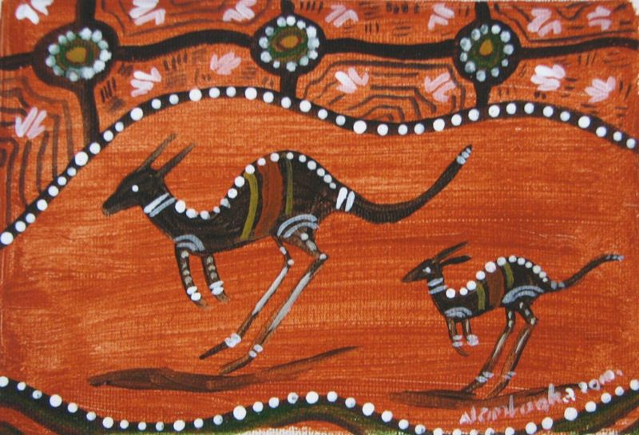
What concept does this image evoke?
http://australianativeart.com/wp-content/uploads/kangaroo-painting-Bea-Edwards.jpg

Slide 20
Scientific taxonomy

Slide 21
Example Cinquain poem
Kangaroo
Furry marsupial
Hopping, jumping, bounding
Proud emblem of Australia
Macropod
http://www.kidcyber.com.au/topics/Austanimalsunit.htm

Slide 22
What concept does this musical composition evoke?
Batttle Hymn of the Republic.

Slide 23
Respiration

Slide 24
Example re-worked song lyric
My eyes have seen the glory of respiratory chain
In every mitochondrium intrinsic to membranes
Functionally organised in complex sub-domaines
Where electrons flow along
Glory, glory respiration (3x)
Where electrons flow along
http://jcdverha.home.xs4all.nl/scijokes/2_1.html#Archimedes_3

Slide 25
Activity
Using the given stimulus material, create the following types of poetry:
Free verse
Acrostic
Cinquain
Haiku
Limerick

Slide 26
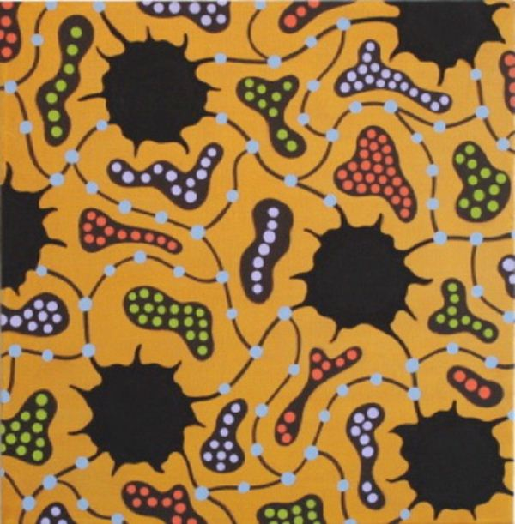
STIMULUS IMAGE 1
http://www.sciencefriday.com/slideshows/daytonslide/600_450/max.jpg

Slide 27
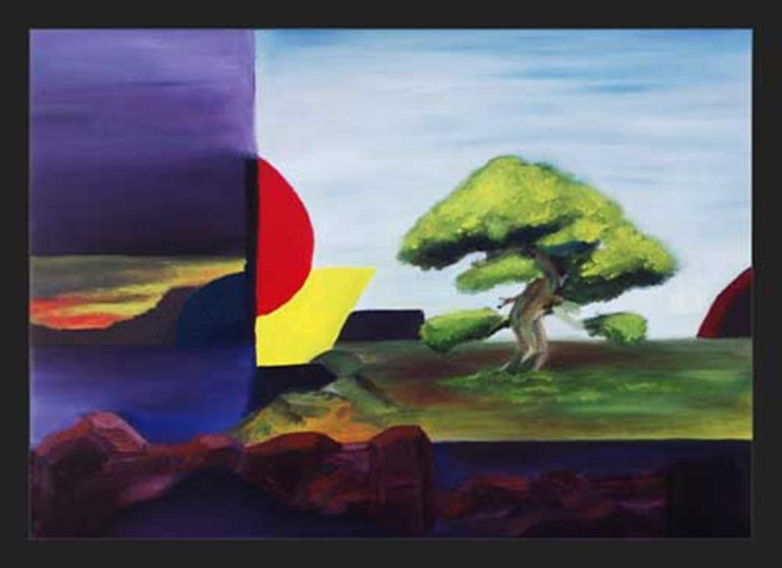
STIMULUS IMAGE 2
http://www.wetcanvas.com/Community/images/17-Sep-2009/26096-SpiritOfTheBonsai.jpg

Slide 28
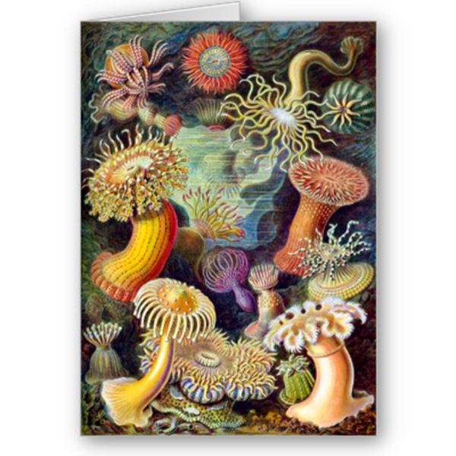
STIMULUS IMAGE 3
http://www.zazzle.co.uk/actiniae_illustration_painting_germa_ernst_haeckel_card-137549220884959491

Slide 29
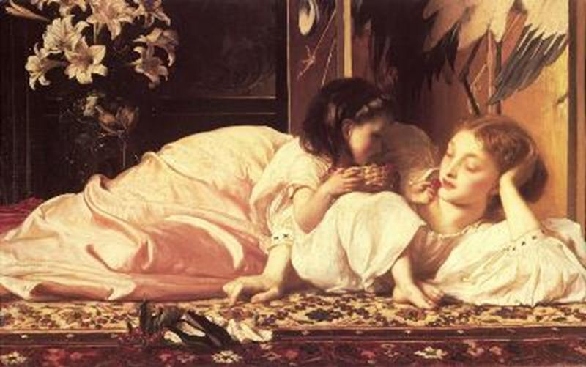
STIMULUS IMAGE 4
http://www.oilpainting.ws/upload/Classic-reproduction/Lord%20Frederick%20Leighton/mini/Leighton_Mother_and_Child.jpg

Slide 30
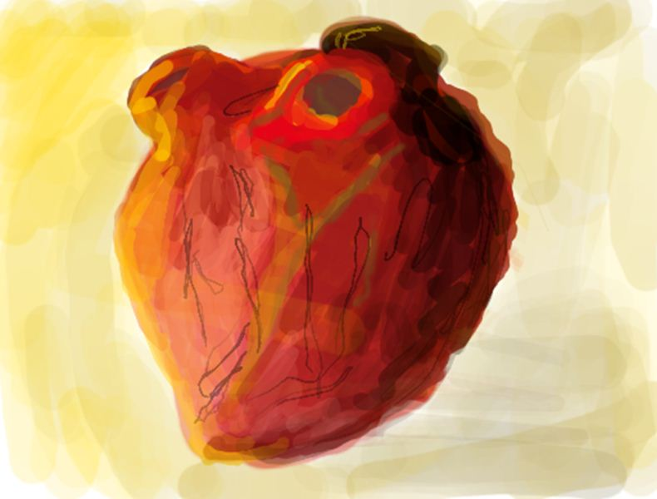
STIMULUS IMAGE 5
http://othep.files.wordpress.com/2007/12/colors_slot7.png

